Slide 1
Spring Security
Abdul, Tom, Pekun
Notes:
Good Afternoon,
My name is Abdul, this is Thomas and Theodore.
This presentation is about spring Security.

Slide 2
Presentation Overview
What is Spring Security?
Spring Security Architecture (Authentication and Access Control)
Configuring Spring Security
Conclusion
References
Notes:
This is quick overview of what this presentation will be about.
So today we are going to talk about :
What is Spring Security?
The Spring Security Architecture
How to Configure Spring Security and the Conclusion

Slide 3

What is Spring?
Spring Framework is a Java platform that provides comprehensive infrastructure support for developing Java applications.
Spring is a lightweight framework. It can be thought of as a framework of frameworks because it provides support to various frameworks such as Struts, Hibernate, etc.
Notes:
Spring Framework is a java platform that supports infrastructure for developing java application.
Spring is a lightweight framework. It can be used as a framework of frameworks because it provides support to various frameworks such as Hibernate.
Hibernate is an object-relational mapping tool for the Java programming language.
Struts open-source web application framework for developing Java EE web applications

Slide 4
Spring Security
Spring Security is a framework that focuses on providing security to Java EE-based enterprise software.
It focuses on providing authentication and authorization to Java applications.
Some features include protection against :
SQL Injection
Sensitive Data Exposure
XSS
Notes:
Spring security is a framework that focuses on providing security to java based enterprise software.
It focuses on providing authorisation and authentication to applications.
Some features include protection against:
XSS,
SQL Injection,
Sensitive Data Exposure.

Slide 5
OWASP 2017 Top 10 - Spring Security Support
Vulnerability | Support | Examples of Spring-Boot Ecosystem Support
A1:2017 - Injection | ✔ | Spring JDBC, Spring Data JPA
A2:2017 - Broken Authentication | ✔ | SS Authentication Manager
A3:2017 - Sensitive Data Exposure | ✔ | SS PasswordEncoder (encryption algorithms with salting)
A4:2017 - XML External Entities (XXE) | ?
A5:2017 - Broken Access Control | ✔ | Attribute Based Access Control, Role Based Access Control, etc
A6:2017 - Security Misconfiguration | ✔ | Always authenticate all endpoints by default. (Spring Boot, Spring Integration and Spring MVC)
A7:2017 - Cross-Site Scripting (XSS) | ✔ | Content-Security-Policy (Spring security provides a number of security headers by default)
A8:2017 - Insecure Deserialization | ?
A9:2017 - Components with Known Vulnerabilities | ?
A10:2017 - Insufficient Logging & Monitoring | ✔ | Spring-Boot actuator (collection of metrics)
Notes:
As i mentioned previously, Spring security mainly support authentication and authorisation. This here is a list of Owasp top 10 vulnerabilities that spring security also tries to support.
For example,
For broken authentication, the SS Authentication Manager (which is a container for authentication providers) can be used to mitigate broken authentication in software applications.
JDBC - Java Database Connectivity.
JPA - Java Persistence API.

Slide 6
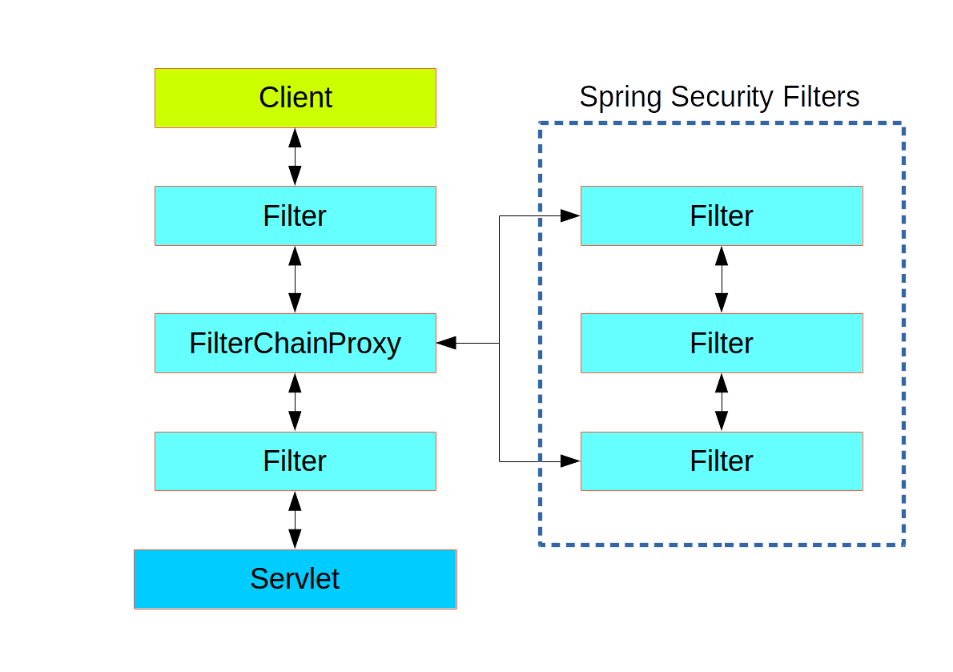
Architecture - Spring-security-web module
HTTP request filtering Spring Security maintains a filter chain internally where each of the filters has a particular responsibility and filters are added or removed from the configuration depending on which services are required. Authentication - Who are you? Access control (authorization) - Can you do it?

Slide 7
Architecture - Authentication Example
Spring Security has an architecture that is designed to separate authentication from authorization, and has strategies and extension points for both.
HTTP Request
Filter
Server
Filter
User makes an HTTP request
Filter decides resource is protected and either:
redirects to authentication form
retrieves identity (cooked etc)
The server will decide if the presented credentials are valid.
If valid, the next step will happen.
If they're invalid, usually your browser will be asked to try again
The original request that you made to cause the authentication process will be retried.
If you have sufficient access, the request will be successful.
Otherwise, HTTP error code 403 ("forbidden").
Notes:
Authentication Example:
You visit the home page, and click on a link.
A request goes to the server, and the server decides that you've asked for a protected resource.
As you're not presently authenticated, the server sends back a response indicating that you must authenticate. The response will either be an HTTP response code, or a redirect to a particular web page.
Depending on the authentication mechanism, your browser will either redirect to the specific web page so that you can fill out the form, or the browser will somehow retrieve your identity (via a BASIC authentication dialogue box, a cookie, a X.509 certificate etc.).
The browser will send back a response to the server. This will either be an HTTP POST containing the contents of the form that you filled out, or an HTTP header containing your authentication details.
Next the server will decide whether or not the presented credentials are valid. If they're valid, the next step will happen. If they're invalid, usually your browser will be asked to try again (so you return to step two above).
The original request that you made to cause the authentication process will be retried. Hopefully you've authenticated with sufficient granted authorities to access the protected resource. If you have sufficient access, the request will be successful. Otherwise, you'll receive back an HTTP error code 403, which means "forbidden".

Slide 8

Architecture - Access Control
To recap from Liliana’s slides:
Access Control is:
Concerned with authorization: what a subject is allowed to perform
Mediates subject’s access to objects
Enforces a security policy, limiting which actions are allowed.
Spring Security mediates user’s access to objects

Slide 9
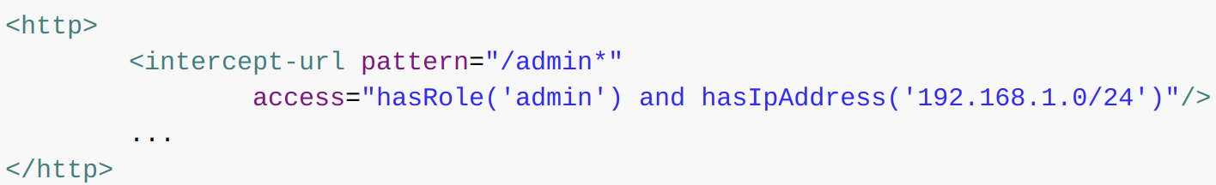
Architecture - Access Control in Spring Security
Spring Security 3.0 (2009) introduced the ability to use Spring Expression Language expressions as an authorization mechanism:
Attribute Based Access Control (ABAC) AKA Policy-based access control
Makes decisions based on complex policy rules (combining attributes together)
Attributes: user, resource, object, environment etc.
For example: IF the requestor is a manager, THEN allow read/write access to sensitive data
Other access control implementations are also supported e.g.: Role Based Access Control, MAC etc

Slide 10
Configuring Spring Security
The Spring Boot Dependency needs to be included.
This can be done via Maven or Gradle.
All one needs to do is to add Spring Security to the class path by including spring-boot-starter-security.
Once Spring Security is on the classpath, then Spring Boot automatically secures all HTTP endpoints with "basic" authentication.
Notes:
Spring Boot is included because Spring Security is under Spring Boot

Slide 11
Configuring Spring Security
In order to configure Spring Security to work with actual users a class that extends WebSecurityConfigurerAdapter is created.
This class is annotated with @Configuration and @EnableWebSecurity
By overwriting the configure(HttpSecurity http) method, one can specify which exact paths should be secured or not.
The userDetailsService() method allows one to add valid user credentials to the web app typically through a database. In this method the developer can also specify various roles for the users.
For the database connection the Spring Data JPA dependency is required as well as specifying the connector for the DB being used.

Slide 12
Configuring Spring Security
The logout functionality is accessed by adding @{/logout} as the form action of the sign out button defined in the app.
After these steps, one should have a fully working secure application with Authentication and Authorisation handled by Spring.

Slide 13
Conclusion
Spring Security and the Spring ecosystem is very useful for improving your webapp’s security, but it cannot prevent all types of vulnerabilities;
IBM’s “2014 Cyber Security Intelligence Index” found that 95 percent of all security incidents involve human error. Using Spring Security helps to reduce human error as most of the core tasks are handled by Spring.
Spring Security is the defacto standard for securing Spring Based applications and it mainly helps to protect against Broken Authentication and Broken Access Control.

Slide 14
References
Spring Security Architecture - https://spring.io/guides/topicals/spring-security-architecture
Spring Security Refence Documentation https://docs.spring.io/spring-security/site/docs/5.2.0.BUILD-SNAPSHOT/reference/htmlsingle/
Spring Security Wikipedia
https://en.wikipedia.org/wiki/Spring_Security
A fresh look at Spring Security Access Control
https://www.axiomatics.com/blog/spring-security-access-control/
Getting Started with Spring Security
https://spring.io/guides/gs/securing-web/

Slide 15
Any Questions?

